Slide 1
Diabetes Prediction System

Slide 2
whoa!
For More Imformation
Visit : GitHub Repository
Contact Us : se.abdelrahman968@gmail.com
T
0

Slide 3
TABLE OF CONTENTS
01
03
Problem Statement
Proposed Methodology
04
05
Results
Conclusions
02
Related Work
T
0

Slide 4
01
Problem Statement
Understanding the Importance of Early Diabetes Detection
T
1

Slide 5
INTRODUCTION
Diabetes is a chronic disease that occurs when the body is unable to produce or effectively use insulin, leading to high blood sugar levels. The World Health Organization (WHO) reports that over 422 million people suffer from diabetes, and the number continues to rise due to lifestyle changes, obesity, and genetic factors.
The condition is often asymptomatic in its early stages, making it difficult for individuals to recognize the risk until significant damage has already occurred. Late detection can result in severe complications such as cardiovascular diseases, kidney failure, vision loss, and even amputations.
T
1

Slide 6
Problem
The challenge lies in the lack of early and accurate screening tools that can predict the risk of diabetes in individuals using readily available health data. Traditional diagnostic methods can be time-consuming and may not be feasible for large-scale health screenings.
Late detection can lead to severe complications and high treatment costs, placing a burden on healthcare systems and reducing the quality of life for affected individuals.
T
1

Slide 7
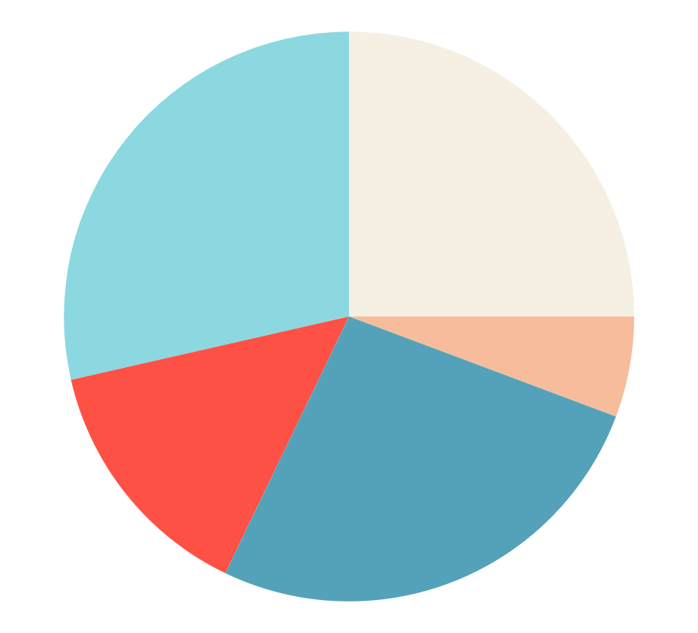
Risk factors
Hyperlipidemia
Obesity
15,0%
23,8%
Current Smoker
Sedentarism
7,5%
7,5%
Hypertension
22,5%
For more info, click here
T
1

Slide 8
THE EFFECTS OF DIABETES
Eyes
Heart
Risk of Diabetic Retinopathy and Vision Loss
Impact on Cardiovascular Health
Liver
Kidneys
Impact on Liver Function and Metabolism
Risk of Kidney Disease and Failure
Intestines
Blood
Effects on Digestion and Nutrient Absorption
Effects on Blood Circulation and Glucose Levels
T
1

Slide 9
FIRST SYMPTOMS OF DIABETES
1
HEADACHE
A common early sign due to high blood sugar levels.
2
BLURRY VISION
Caused by fluid changes in the eyes, affecting focus.
3
tiredness
Fatigue results from the body’s inefficiency in using glucose for energy.
T
1

Slide 10

RISK AGE TyPE 1 DIABETES
4-7 years
60%
Despite being red, Mars is actually a cold place
10-14 years
40%
Mercury is the closest to the Sun of them all
For more info, click here
T
1

Slide 11
02
Related Work
Overview of current research and methods
T
2

Slide 12
Related Work
Study | Year | Method Used | Results | Limitations
Smith et al. | 2020 | Logistic Regression | Accuracy of 85% | Limited data diversity
Chen et al. | 2021 | Random Forest Classifier | Accuracy of 90% | High computational cost
Lee & Kim | 2019 | Decision Tree | Precision of 80% | Prone to overfitting
Patel et al. | 2022 | Support Vector Machine | Recall of 87% | Not robust to noisy data
T
2

Slide 13
Timeline of AI-Powered Treatment Developments
AI in Medical Imaging
Machine Learning for Personalized Medicine
2012
2017
2010
2015
2018
Early AI Integration
AI for Diabetes Management
AI-Driven Drug Discovery
T
2

Slide 14
Timeline of AI-Powered Treatment Developments
AI for Treatment Optimization
AI-Powered Robotic Surgery
2021
2023
2020
2022
2024
Advances in Predictive Analytics
AI in Continuous Glucose Monitoring (CGM)
Next-Generation AI Models
T
2

Slide 15
03
Proposed Methodology
Approach for Developing an Accurate Diabetes Prediction Model
T
3

Slide 16
Proposed Methodology
Data Preprocessing
01
03
02
Data Collection
Feature Selection and Engineering
T
3

Slide 17
Proposed Methodology
Model Evaluation
04
06
05
Model Selection and Training
Validation
T
3

Slide 18
Data Collection
Utilized a publicly available dataset containing various health-related attributes.
Ensured data includes relevant features like age, BMI, blood glucose levels, and more.
Data Preprocessing
Handled missing data and performed feature scaling using MinMaxScaler for normalization.
Coded categorical features with LabelEncoder to convert non-numeric labels into numerical values.
T
3

Slide 19
Feature Selection and Engineering
Selected features based on domain knowledge and correlation analysis.
Created new features if necessary for better prediction.
Model Selection and Training
Applied multiple machine learning algorithms: Logistic Regression, Decision Trees, Random Forests, Gradient Boosting, and Support Vector Classifier (SVC).
Used GridSearchCV for hyperparameter tuning to optimize model performance.
T
3

Slide 20
Model Evaluation
Compared model performance to select the best-performing algorithm.
Evaluated using metrics like accuracy, precision, recall, F1-score, and confusion matrix.
Ensured data includes relevant features like age, BMI, blood glucose levels, and more.
Validation
Split data into training and test sets for robust validation.
Performed cross-validation to ensure consistent results.
T
3

Slide 21
Implementation
Finalized the best model and created a user-friendly interface to input data and obtain predictions.
T
3

Slide 22
04
Results
Evaluation and Performance Metrics of the Model
T
4

Slide 23

The model being worked on
Logistic Regression
Decision Tree
Gradient Boosting
Random Forest
SVM Model
T
5

Slide 24
Accuracy results
95.93%
SVM Model
A reliable baseline model that performed well for binary classification.
95.91%
SVM Model
Highly effective in finding the optimal hyperplane for classification, with comparable accuracy to logistic regression.
99.93%
Random Forest
Outperformed other models significantly, showing exceptional performance due to its ensemble approach.
T
5

Slide 25
Accuracy results
97.13%
Gradient Boosting
Demonstrated strong predictive capabilities with boosting techniques to improve accuracy.
97.08%
Decision Tree
Performed well but slightly lower than ensemble models, providing clear and interpretable decision boundaries.
T
5

Slide 26
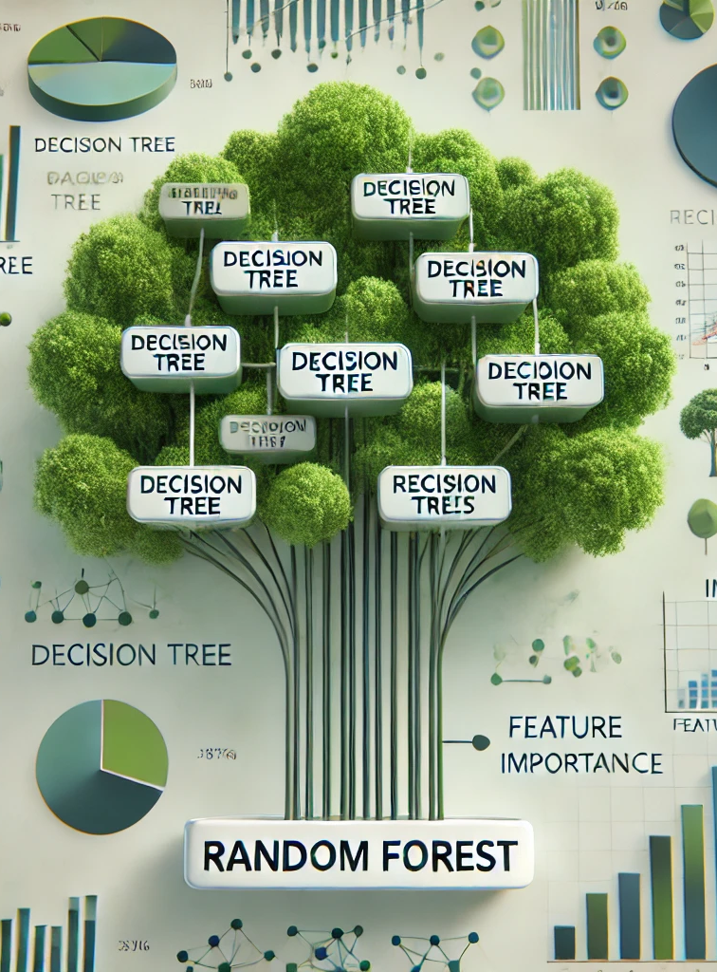
Random Forest Classifier
Key Points:
Model: Random Forest Classifier
Accuracy: 99.93%
Why It Stood Out:
Ensemble Method: Combines multiple decision trees to improve prediction accuracy.
Robust Performance: High accuracy indicates strong generalization to unseen data.
Feature Importance: Capable of providing insight into the importance of each feature.
Resilience: Handles overfitting better than individual decision trees.
Conclusion: The Random Forest Classifier outperformed all other models in terms of accuracy, making it the most suitable choice for this diabetes prediction task.
T
4

Slide 27
05
CONCLUSIONS
Key Takeaways and Future Directions
T
5

Slide 28

Conclusions
Model Performance:
The Random Forest Classifier demonstrated the highest accuracy at 99.93%, showcasing its effectiveness in diabetes prediction.
Comparison with Other Models:
Logistic Regression, SVM, and Gradient Boosting Classifier also showed strong results with accuracies of 95.93%, 95.91%, and 97.13%, respectively.
Decision Tree achieved 97.08%, proving its usefulness for simpler models.
T
5

Slide 29
Conclusions
Key Insights:
Ensemble models like Random Forest provide significant performance improvements due to their ability to combine multiple decision trees to enhance predictions.
The results suggest that tree-based algorithms are highly suitable for complex classification tasks like diabetes prediction.
T
5

Slide 30

Future Work
Implementing additional data preprocessing and feature engineering.
Future Work
Exploring the integration of more advanced models such as neural networks.
Real-time deployment of the model for practical use.
T
5

Slide 31

OUR TEAM
Abdelrahman Ayman Elsayed
Abdulrahman Ashraf Mokhtar
Abdulbari Sabry Abdulbari
Sami Mohammed
Sami
T
5

Slide 32
Thanks!
Do you have any questions?
se.abdelrahman968@gmail.com
+20 1275502636
T
6

